Slide 1
Overview of Data Visualization
Notes:
This presentation is all about data visualization. We will talk about different types of data visualization techniques and designs as well as go over some important steps to consider when creating your own data visualizations. We’ll end this presentation going over a few simple techniques to help you create visualizations using mHero data.

Slide 2
Turning Data into Art
Tufte?
The purpose of visualization is insight, not pictures.
- Henry D Hubbard
Visualizations act as a campfire around which we gather to tell stories.
Al Shalloway
Above all else, show the data.
- Edward Tufte
Notes:
Data Visualization is often seen as an art. Here are a few quotes from some people well known in the field of data visualization. I particularly like the second one: “Visualizations act as a campfire around which we gather to tell stories.”

Slide 3
Data from 2014 Ebola Outbreak
WHO report date | Total Cases, Guinea | Total Deaths, Guinea | Total Cases, Liberia | Total Deaths, Liberia | Total Cases, Sierra Leone | Total Deaths, Sierra Leone
7/24/14 | 415 | 314 | 224 | 127 | 454 | 219
7/28/14 | 427 | 319 | 249 | 129 | 525 | 224
7/31/14 | 460 | 339 | 329 | 156 | 533 | 233
8/3/14 | 472 | 346 | 391 | 227 | 574 | 252
8/4/14 | 485 | 358 | 486 | 255 | 646 | 273
8/8/14 | 495 | 367 | 554 | 294 | 717 | 298
8/12/14 | 506 | 373 | 599 | 323 | 730 | 315
8/13/14 | 510 | 377 | 670 | 355 | 783 | 334
8/15/14 | 519 | 380 | 786 | 348 | 810 | 348
8/19/14 | 543 | 394 | 834 | 466 | 848 | 365
8/21/14 | 579 | 396 | 972 | 576 | 907 | 374
8/22/14 | 607 | 406 | 1082 | 624 | 910 | 392
8/28/14 | 648 | 430 | 1378 | 694 | 1026 | 422
9/6/14 | 812 | 517 | 1871 | 1089 | 1261 | 491
9/8/14 | 862 | 555 | 2046 | 1224 | 1361 | 509
9/12/14 | 861 | 557 | 2081 | 1137 | 1424 | 524
9/16/14 | 936 | 595 | 2407 | 1296 | 1620 | 562
9/18/14 | 942 | 601 | 2710 | 1459 | 1673 | 562
9/22/14 | 1008 | 632 | 3022 | 1578 | 1813 | 593
9/24/14 | 1022 | 635 | 3280 | 1677 | 1940 | 597
9/26/14 | 1074 | 648 | 3458 | 1830 | 2021 | 605
10/1/14 | 1157 | 710 | 3696 | 1998 | 2304 | 622
10/3/14 | 1199 | 739 | 3834 | 2069 | 2437 | 623
10/8/14 | 1298 | 768 | 3924 | 2210 | 2789 | 879
10/10/14 | 1350 | 778 | 4076 | 2316 | 2950 | 930
10/15/14 | 1472 | 843 | 4249 | 2458 | 3252 | 1183
10/17/14 | 1519 | 862 | 4262 | 2484 | 3410 | 1200
10/22/14 | 1540 | 904 | 4665 | 2705 | 3706 | 1359
10/25/14 | 1553 | 926 | 4665 | 2705 | 3896 | 1281
10/29/14 | 1906 | 997 | 6535 | 2413 | 5235 | 1500
10/31/14 | 1667 | 1018 | 6535 | 2413 | 5338 | 1510
11/5/14 | 1731 | 1041 | 6525 | 2697 | 4759 | 1070
11/7/14 | 1760 | 1054 | 6619 | 2766 | 4862 | 1130
11/12/14 | 1878 | 1142 | 6822 | 2836 | 5368 | 1169
11/14/14 | 1919 | 1166 | 6878 | 2812 | 5586 | 1187
Notes:
Here is a snapshot of a table of numbers representing the number of Ebola cases and deaths by country. This table, updated every few days since the beginning of the outbreak in 2014, runs 157 lines long. There is a lot of great information here but it is hard to see what all these numbers mean.

Slide 4
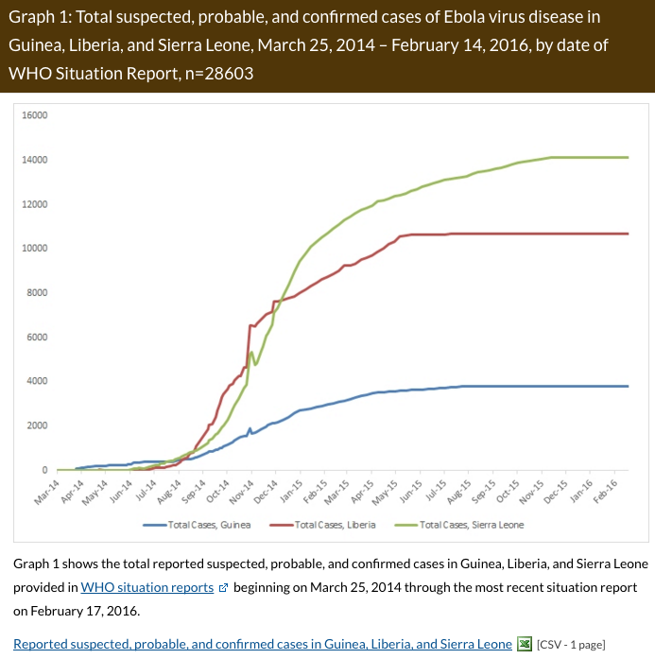
Line Graph
Image: www.CDC.gov
Notes:
Here is that same table of data converted into a graph. You can see here by country, the rise in the number of reported suspected probable and confirmed Ebola cases by country over this long time period. You can clearly see a sharp increase in the number of cases from September – December 2014.

Slide 5
Map
Image: www.CDC.gov
Notes:
Here you can see a map representing the number of deaths. Notice the shading in the map to help highlight higher percentages in counties or districts within the outbreak countries.

Slide 6
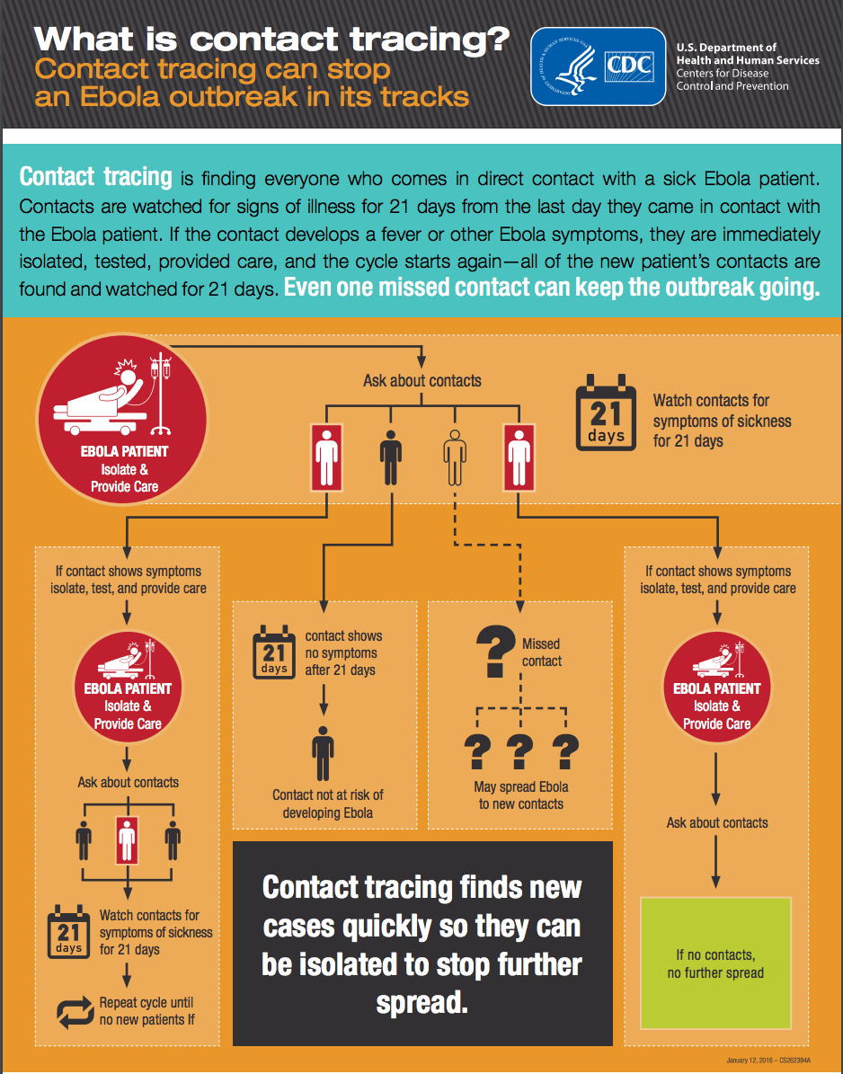
Infographic
Notes:
This image is an infographic – this particular one is explaining how contract tracing works. Notice the definition at the top but the pictorial images at the bottom that illustrate how contact tracing works. If you follow the “Ebola patient” in the top left corner, you can see how contact tracing follows up with those that were in contact with the patient and for how long in order to monitor them for Ebola.

Slide 7
Data Visualization
Data Visualization helps to visually represent data
Helps tell the story
Great tool for advocacy and decision making
Aids visual perception and cognitive thinking
Notes:
All of these were examples of data visualization – maps, graphs and images that translate data into an image that visually represents data.
Data visualization is loosely defined as the process of visually representing data.
It is a way to communicate complex ideas quickly and clearly so that people understand their significance. Using data visualization can help you present complex ideas in a simple way to visually tell a story. It is also more engaging and compelling – prompting action and data use.
Global health professionals are often tasked with communicating data to decision makers. It is a great tool for advocacy.
Data visualization principles are based on the science of perception and cognition.

Slide 8
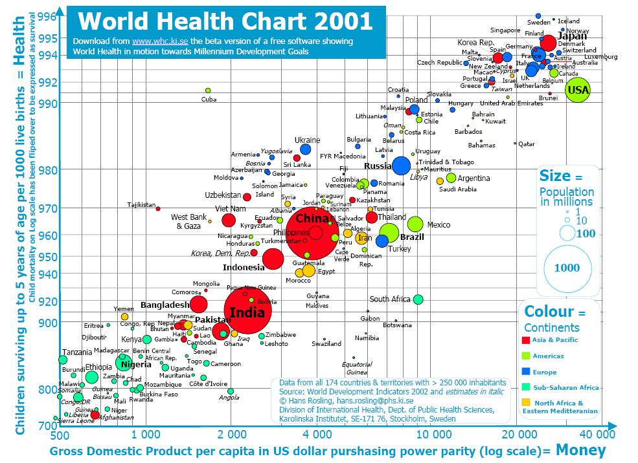
More Examples
Notes:
Let’s take a look at another data visualization. This image was created by Hans Rosling – a very well known presenter data visionary who has developed some compelling data visualizations that illustrate different dynamics between population growth.
In looking at this image, you can see on the x axis, the horizontal line at the bottom, figures for gross domestic product per capita in dollars. The y axis, the vertical line, shows the number of children surviving up to five years of age. The bubbles each represent a country. The circle colors represent continents. The size of the circle correlates with population in the country. There is a key on the right side of the image that indicates which colors correlate with which continents and the size of the population in millions based on the size of the circle.
What does this tell you?
You can infer that the higher the GDP, the higher child survival rates. Look at India – it has one of the largest populations and falls toward the lower end of the GDP and has lower child survival.
Look at the colors of the countries – what countries are at the bottom left of the image? These represent a lot of the African continent.
We inferred a lot of information from this one image. Imagine if you were a policy maker for reproductive health in say, Nigeria, how could you use this kind of information to advocate for more resources for family planning?
You can view Hans Roslin’s explanation of statistics on YouTube: https://www.ted.com/talks/hans_rosling_shows_the_best_stats_you_ve_ever_seen?language=en

Slide 9
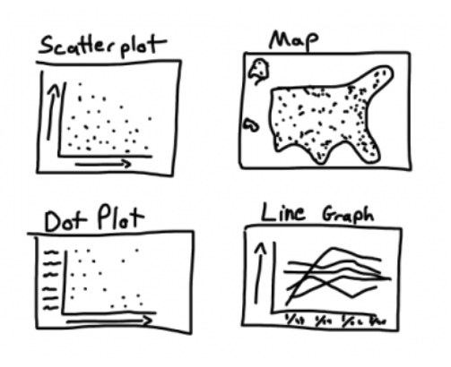
Traditional Designs
Image: GHeL
Notes:
That was a very complex example of data visualization. We often use simpler ones. There are four traditional designs when considering data visualizations – a scatterplot, a map, a dot plot and a line graph.
Traditional charts and graphs like scatter plots can be useful for reports and telling a specific data story. Graphs and charts are often created in programs like Excel. Static graphics and charts do not allow you to uniquely manipulate or display your data, but are great tools for showing trends and other changes over time or across categories.
Maps tell a geographic story: How service availability varies by place, how environment influences health, and how the health of a population varies by region, urban/rural residence, or even proximity to roads. Maps at the national, subnational, and local levels are useful and can be created in GIS software or using a variety of online tools.

Slide 10
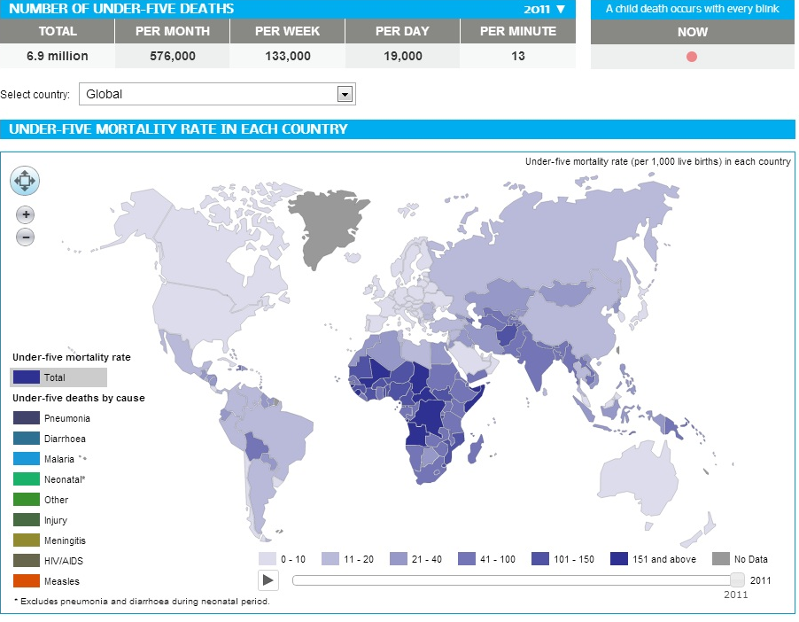
Infographics and Dashboards
Notes:
There are also more sophisticated and interactive infographics and dashboards.
Infographics, like our example earlier on contact tracing, use a series of graphics, including graphs, charts, illustrations, and more, to visually convey a story. They may be manually drawn and typically involve a graphic designer. Today’s infographics are usually created on a computer and combine multiple data points and illustrations to tell a bigger story, and may combine qualitative and quantitative information.
Interactive websites present quantitative data and are generated by software, and include dashboards for project data. The image here is a screenshot of a dashboard – an interactive graphic. Dashboards are gaining popularity but require a lot of effort to develop and require maintenance to ensure data quality and integrity.

Slide 11
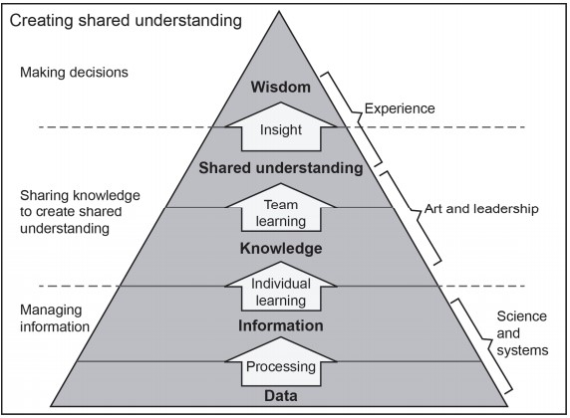
Reality to People’s Brains
Image: datathenewoil.com
Notes:
Why do data visualizations work for data use?
Take a look at this pyramid in this slide. We start at the bottom – with a lot of data. It takes science and systems to process that data into information. You can see that action on the right. On the left you see “Managing Information”. We all know how much effort it takes to manage health information systems and other data systems.
Moving up the pyramid you see that data can become information – this happens when you run reports and do analysis. Through this you gain knowledge. You begin to understand the story your data is telling you. When you create a data visualization that knowledge becomes a tool to share with others. You can created a shared understanding together and provide insight into the findings. It is at this level – when that data becomes wisdom - that decisions are made. This requires experience.

Slide 12
Reality of data visualization in health
Notes:
Data Visualization is a great tool for data use in public health. As you’ve seen, there many creative and informative ways to present sophisticated visual stories. They can help decision makers understand and interpret data.
However, the reality is most of our data sits on a shelf or in a system and is not used in this way. Why?
There are often limited resources in terms of capacity to build quality data visualizations as well as have access to the training and technology to create the visuals.
There are a lot of tools available for free online to help but if connectivity is poor, users will have a hard time accessing and using those tools.
Another challenge is the analytical capacity of users. Since this varies across stakeholders in public health, some tools may be hard to interpret and understand.
Also our culture does not demand data visualization. Many reports are text heavy and data visualization has traditionally not been a part of the data use culture.

Slide 13
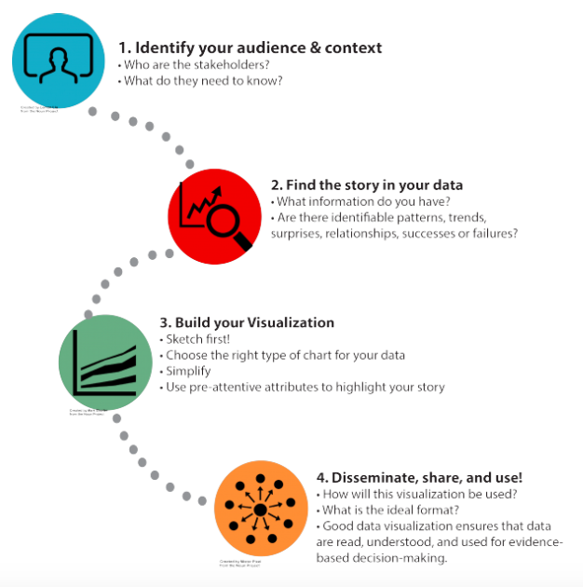
Important Steps
Image: GHeL
Notes:
Now let’s go over a few important steps to remember when creating your data visualizations. These are helpful for mHero users and stakeholders who may be asked to create data visualizations. System administrators may be asked to help develop technology to support data visualizations and it is important they be aware of the process.
Users are people who use the mHero system to develop and execute use cases.
Stakeholders are leaders and managers involved in requesting use cases and guiding the questions posed and data collected. They use the information collected to help make decisions or develop health policies.
System administrators are technical staff who manage the ICT systems (servers, infrastructure, and software) used by the MoH or health system organization.
They assist in the technical implementation of mHero by implementing components needed as well as linking them into a working system.

Slide 14
Know your Audience
Align data visualizations with the goals of your stakeholders
Consider their literacy
Don’t assume everyone is comfortable with technology
Think about how your audience will use the visualizations
Notes:
The first step is to know your audience – who are you creating this visualization before. We talked in the last presentation about knowing your stakeholder and their goals. Are you creating an image that helps them understand data related to those goals?
There are a few other things to consider as well regarding your audience:
● Literacy: Data visualization can be a great way of sharing important information in low-literacy areas. If your audience is not highly literate, make sure you are relying on symbols, illustrations, and other universally-understood elements.
● Numerical literacy (numeracy): While most educated audiences will be literate, do not assume that they are all comfortable with data and math. Do they understand percents? Ratios? Do they understand Do some concepts need to be explained?
● Comfort with technology and graph formats: Not everyone can look at a scatterplot and instantly interpret it. Similarly, while dashboards have become the norm in many settings, globally there are audiences with low bandwidth, less comfort with technology, and less exposure to these formats.
● Level of Technical Expertise: Population and health topics are varied and complex. A college degree does not make someone an expert in population, nutrition, or mortality data. Simplify your message and define key terms and concepts for less technical audiences and provide more detail and technical points for those with higher levels of expertise.
● Job Function: Is your data visualization geared towards program managers or policy makers? Funders, health care workers, academics, or the general public? Not only will the job function indicate how the audience may use the data, it will also suggest the visualization format that will work the best.

Slide 15
Find your Story
Look for patterns, trends, and surprises
Compare and contrast
Avoid cherry picking
Avoid exaggeration
Notes:
Once you have analyzed your data, you should look for patterns, trends and surprises emerge. You probably have some hypothesis about what the data will tell you so digging through it confirm those assumptions or see what new things might emerge is where you need to spend a lot of time.
Patterns happen in a regular and repeated way, and, in data, often indicate that two things are related. Trends show change over time. For routine workflows, you should look at the data to see how responses change and what health worker needs emerge.
Surprises are those data that you did not expect or go completely against your hypothesis. Sometimes these are outliers.
Comparisons contrast two or more data points. Say you have a workflow that is sent to multiple districts. You can see how the data relates from one district to another. One may have a shortage of supplies where others do not. You could use this to find out why and see if any extra supplies can be sent from one district to another for a quick fix.
When looking through your data to find your story, you should avoid cherrypicking – that means only selecting the most desirable data and results.
Also be careful in how you present your story. Avoid exaggeration. For example, If you have data that tells you 75% of health workers messaged through mHero would like more information on breastfeeding practices but in reality you only have responses from 4 people, you wouldn’t want to make a recommendation for a large breastfeeding training.

Slide 16
Consider design
Choose the right image to represent your data
Try sketching on paper to brainstorm
Notes:
It is important to choose the right image or design to represent your data. Sometimes maps are the best tools if you want to show geographic spread and comparison. Often graphs will be better than scatter plots.
One tip is to look at your data and sketch on paper what kinds of ideas might work to visually represent the story you are trying to tell with your data.
A few tips if you are using Excel for designing your data:
Pie Charts are best to use when you want to showcase parts of a whole response. For example, if you want to showcase how one cadre of health workers responds to which in-service training they need, you could use a pie chart. See the example in the slide that shows what areas of in-service training nurses in “X” district indicated they needed. As you can see, the highest area is chronic disease and the lowest is malaria. Please note this is just illustrative data.
Bar and Line Graphs are great for showing data over time. Look at the same question but assuming data was collected over six years. If you are a HIV trainer you can see an increase in 2015 in the need for IST for nurses. If you are sitting in the department of family planning you can infer a large increase in the need for FP training since 2012.
We encourage you to look through the Data Visualization 101: http://bit.ly/1T65d2f

Slide 17
Share and Communicate
Obtain input and feedback from your colleagues
Sharing data visualization can help improve awareness and use of data
Consider sharing through social media
Notes:
Sharing and communicating data visualization products helps to ensure they are used to inform policy and programs. Remember that the data visualization and data use processes begin with identifying your audience and asking, “What do they need to know and what will they do with the information?” Effective data visualization quickly and visually conveys useful information, ideally urging the recipient to take action. One suggestion is to share your data visualization with your colleagues for feedback before widely disseminating or including it in a report.
Data visualization products should be actively disseminated to the intended audiences to improve awareness and use.
You can share visualization in reports and with the correct approvals, share them through blogs, social media and other publically available outlets. If you take some time to google “data visualization” or “cool data viz” you will find some really interesting things. This never would be available if others hadn’t shared it.

Slide 18
mHero and Data Visualization
Some tools are available in RapidiPro
Good data analysis will help you tell a story about data from:
A full workflow
Multiple workflows on a health worker or a facility’s needs
Overall use of mHero in a facility; county; country
Infographics for awareness raising
Notes:
Let’s talk now about data visualization and mHero.
There are some tools available in RapidPro that can help with seeing results. You can see by individual response how people responded to a yes/no question either by selecting to view the data as a pie chart or a graph.
However, the best way to analyze your data to create strong data visualizations is to export raw data from iHRIS and customize your views. You can illustrate responses from individual workflows – how did health workers respond to each question? For multiple workflows you can track responses over time. Or you can track use of mHero by facility or county. There are lots of creative ways you can tell the story.
You can also use infographics for awareness raising. Creating a meaning infographic about mHero and how it works would be a great tool to have hanging on a wall in a health facility. It could increase health worker response rates to mHero.

Slide 19
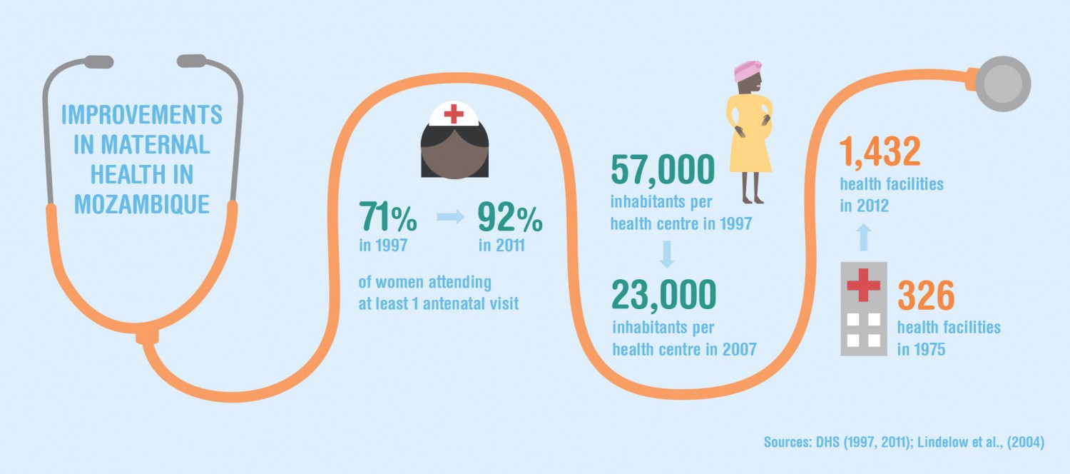
Build with Tools You Know
Maintain focus for your target audience
Simple images
Keep data focused
Ensure it is easy to read
Include a great headline
Make sure the information flows
Cite your sources
Notes:
Let’s talk about building some data visualization with tools you probably already know how to use. Sure there are some really snazzy, sophisticated tools out there and we will reference them at the end of this presentation but the reality is you may not have access to those tools or even the time or money to learn how to use them.
So let’s start with some tools in the Microsoft Suite and Microsoft Powerpoint. How can you use this to build a data visualization?
This is a great tool for building a simple infographic. By designing text using different colors and fonts, and adding in images, you can create a really strong visual.
A few tips for creating infographics:
Keep it focused for your target audience
Keep your images simple
Keep data focused
Ensure it is easy to read (no too small text)
Include a great headline
Make sure the information flows
Cite your sources

Slide 20
Build with Tools You Know
Use Excel to Create Pie Charts, Line Graphs, Scatter Plots and more
Helpful tip is to use the Filter to help identify data you want to use. This can help you identify the counts you need for making charts.
Notes:
Microsoft Excel is where you likely be able to create a lot of powerful visualizations with your quantitative data. You can use excel to create fast and simple pie charts, line graphs, scatter plots and more.
We have a number of resources toward the end of this presentation that offer advice on using excel. Through the case study exercise later you’ll have some hands on time to experiment and make some charts using excel.
One quick tip though is to make good use of the filter function in Excel. This will help you pull specific data for your tables. You can’t include everything from your data set in one table and this can help you focus on what data to highlight in a visual tool in excel.

Slide 21
Want to Learn More
Deep Dive into Ghel Course: https://www.globalhealthlearning.org/course/data-visualization-introduction
Read Edward Tufte, Alberto Cairo
Obtain training using ArcGIS, Tableau, Easel.ly, Picktochart or Infogra.am
Another great source: www.datavizhub.co
Checkout blogger Cole Knaflic at www.storytellingwithdata.com
Notes:
There are so many opportunities for you to expand your learning on data visualization.
We recommend the Data Visualization Introduction Course – a free, self, paced online course available at the Global Health e-Learning site.
There are several books by Edward Tufte – one of the most well known in data visualization. Alberto Cairo also has some easy to read books on design.
For the technically minded, there are several systems you can investigate that offer you more flexibility in creating robust and sophisticated data visuatlizations. These include ArcGIS for maps, Tableau for dashboards, Easelly for inforgraphics and more.
Datavizhub is another good resource.
To read more about data visualization in practice, you can follow blogger Cole Knaflic at storytellingwithdata.com.

Slide 22
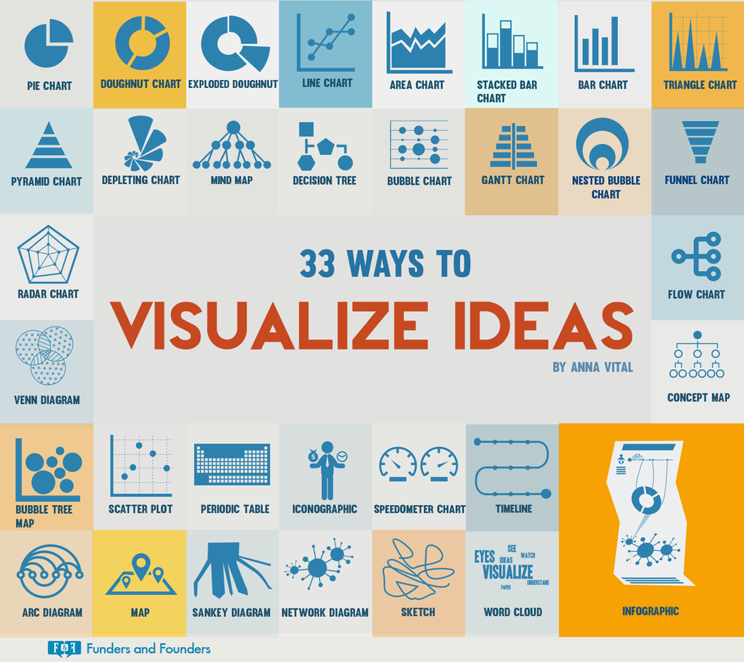
Notes:
Remember, there are so many ways to visualize data. It is really an intersection of art and science. There are a lot of resources to help you and many are provided in the supplemental reading list. We look forward to seeing what you produce!

Slide 23
Thank you!
© IntraHealth International. This document is made available under a Creative Commons Attribution-ShareAlike 4.0 International: https://creativecommons.org/licenses/by-sa/4.0/
This information is made possible by the generous support of the American people through the United States Agency for International Development (USAID). The contents are the responsibility of IntraHealth International and do not necessarily reflect the views of USAID or the United States Government.
Notes:
Slides and Narration by Amanda Puckett BenDor apuckett@intrahealth.org

