Slide 1
mHero : An integrated digital health platform for health worker communication and coordination
Notes:
Hello, my name is <INSERT NAME> and I will be presenting on the mHero platform. Today I’ll talk to you about the platform, the steps to implementing mHero and what you’d need to deploy your own mHero system.

Slide 2
What is mHero?
mHero is a free mobile phone-based platform that:
Connects health workers to their support systems at all levels of the health pyramid
Allows real-time and two-way communication of on-the-ground needs
Is flexible and scalable
Fosters health systems strengthening
Notes:
mHero is a free, two-way, mobile-phone-based communications system that uses basic text messaging, or SMS, to connect ministries of health with health workers. mHero does not require a smartphone or tablet, but rather operates on simple talk and text mobile devices. mHero allows ministries of health to directly communicate messages and collect critical information from those on the front lines of care, playing a critical role in ensuring effective and efficient responses, particularly in times of crisis.
In addition to ensuring a faster and more comprehensive response to health service needs, deployment and scale-up of mHero will also extend the capacity of country stakeholders to develop robust communication and coordination mechanisms that strengthen health systems.

Slide 3
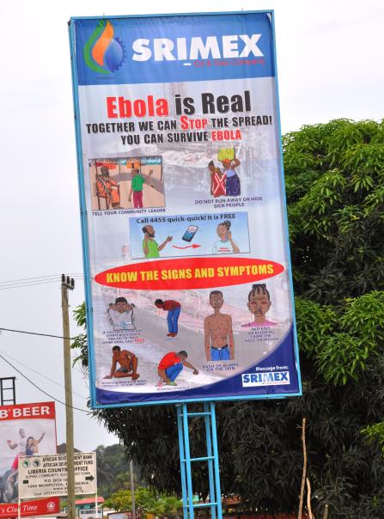
mHero Origins
August 2014 – IntraHealth and UNICEF facilitated interoperability of technology to create mHero
September 2014 - Ministry of Health, Liberia requested mHero pilot
October 2014 - Stakeholder engagement and team-building began at all levels of government
November 2014 – First mHero SMS
sent
Notes:
mHero was created in August 2014 to help Ministries of Health connect with health workers during West Africa Ebola outbreak.
Within a few short weeks, IntraHealth and UNICEF reached out to the Ministry of Health in Liberia to see if this tool would be helpful. They said yes. The MOH prioritized which messages they would like to send to health workers - health workers that were moved to Emergency Treatment Units or leaving the health system all together. Those early use cases were really for the MOH to understand where the health workers were in the country.
IntraHealth worked with the MOH team to build a mHero team within the MOH – a team that would lead the further prioritization of use cases and implement mHero on behalf of the MOH.
The first mHero SMS were sent in Liberia in November of 2014 to validate health worker information.

Slide 4
What Is mHero?
What kind of disease agent causes Ebola? 1)Bacteria 2)Virus 3)Toxin 4)Parasite
PPE
2) Virus
What is your stock level of PPE?
Could you confirm that you are an RN?
Yes, I am an RN
2 PPE available
Notes:
As the platform evolved, more capabilities were added. Now, mHero communications can be initiated by either the health worker or someone at a ministry of health.
In the first conversation, a nurse texts the letters “PPE” to the mHero number. This triggers the receipt of a question asking about her stock level of personal protective equipment (PPE). She is then able to respond that she has 2 only PPE available, altering someone at the ministry that she is very close to a stockout.
In the second conversation, the text initiates at the ministry, with a question to confirm the health worker’s cadre. She responds that she is indeed an RN.
The third conversation illustrates how mHero can be used to send flash surveys or quick refresher trainings.

Slide 5
Effects on Service Delivery
mHero can… | Resulting in…
Validate and consolidate health worker and services data at the national level | More accurate and timely workforce and systems data for decision-making
Conduct rapid ‘flash’ surveys of health workers | Quick data collection from health workers for targeted response
Produce real-time inventory reports | Decreased stock outs and increased safety for health workers
Send structured messages for refresher training and courses | Improved health worker competencies while performing necessary tasks
Target messages to absent workers | More health workers returning to work
Belize
Notes:
This slide illustrates just a few of the ways mHero can be used to strengthen a country’s health system.
As you can see, mHero can embrace a lot of different communications that may result in service delivery enhancements. For example, mHero can collect inventory information and if stockouts are identified, the MOH can use this information to ensure supply chain management challenges are addressed and stockouts are mitigated.
Another example is targeting messages to absent health workers. By reaching out to them, they may be motivated to return to work.

Slide 6
What Is mHero? The Technology
mHero
Facility Information
DHIS2
Interoperability Layer
Message Development
Message Sender
Message Receiver
Facility Data
RapidPro
HW Registry
HW Data
iHRIS
HW Information
Workflow initiator
Data flows from the health workers through RapidPro into iHRIS and DHIS2
Data flows from iHRIS and DHIS2 to RapidPro to enable messages to be sent
Notes:
Now let’s take a look at the technology behind mHero. mHero is not a new technology, but rather a consolidation of technologies typically already in use by most ministries of health.
We mentioned that when mHero was developed, IntraHealth and UNICED made their iHRIS and RapidPro technologies interoperable. There are other systems that are involved too. Specifically:
DHIS2 houses information on service delivery statistics and facilities
iHRIS houses information on health workers, including their mobile phone numbers
SMS messages are developed and tested in RapidPro
DHIS2 and iHRIS are connected through the health worker registry, which connects to RapidPro through an Interoperability Layer
These technologies combine to form mHero, through which SMS are sent to and received from health workers
Data thus flows from DHIS2 and iHRIS through RapidPro to health workers and from health workers back into these databases
It is important to note that the responses health workers send are attached to their files in iHRIS but do not automatically make changes to the data stored in iHRIS.

Slide 7
What Is mHero? The Technology
Facility Registry
Interoperability Layer
CSD
SVS
Inter-Linked Registry
CSD
CSD
Form metadata and data exchange
Notes:
This is a highly technical slide but as you can see, mHero brings together existing components of the health information system through open international interoperability standards for health information exchange, in particular OpenHIE. On the left had side, we have several core components of the OpenHIE architecture including canonical sources of facility and health worker data. These data in these systems are brought together into the InterLinked Registry using the international CSD standard. mHero builds on these core components by connecting the InterLinked Registry to the SMS communication platform RapidPro which is being supported by UNICEF. Data protection, security and synchronization is provided by the InterOperability Layer. At the moment we adding new support for the international “Mobile Alert Communication Management” or mACM standard to the mHero platform. This mACM standard provides a software independent way to send care reminders and alerts in times of crisis or emergency.

Slide 8
mHero Operations
Notes:
Having completed an overview of mHero and its component technologies, let’s take a look at the process for sending mHero SMS.

Slide 9
Step 1: Define the Use Case
1. Define mHero use case
2. Develop and test work flow (RapidPro)
3. Select health workers to contact (iHRIS)
4. Send message to a set of health workers
5. Monitor message transmission
7. Analyze mHero data and act accordingly
6.Export mHero data for analysis
8. Implement use case with another set of health workers or close workflow
Notes:
This circle illustrates the process, or steps taken, to send out a SMS through mHero. The first step is to define the mHero use case, or message topic.

Slide 10
Step 1: Define the Use Case
Questions to ask:
What kinds of information do you need from health workers?
What kinds of information do you need to provide health workers?
What are your challenges in receiving or providing this information?
Notes:
Often times representatives from different units or directorates within the ministry will come to the mHero team with a message topic already in mind. However, when introducing mHero to a ministry, it is important to help people think about how the platform can be used.
Here are some questions that can spur the identification of mHero use cases.
Ask what kinds of information stakeholders at the MOH needs from health workers. Ask if they have information they want to provide and share with health workers.

Slide 11
mHero Use Cases… Quick Examples
Routine
License Renewal and Reminders
Annual Messages
Non Routine
Urgent Alert
HRM Refresher Trainings
Reminder on Key Strategic Health Services
One Way
Notification of Upcoming Event
Two Way
Health system/infrastructure assessments
Validate HRIS Data
Sent by MOH
Dissemination of Information
Reminders on Reporting
Sent by Health Worker
Notification of Outbreak
Request for Supplies
Notes:
As you may be understanding now, mHero can be used for both routine and non-routine messaging, notifications (one way communication) and to ask questions (two way communication). SMS messages can be sent from the MOH to health workers and from health workers to the MOH. This slide provides examples of each. Have a read at the different routine, non-routine, two-way and other message types that can be sent.

Slide 12
Sample Use Cases
Name of Use Case | Description | # | Recipient Type | Location | End User of Data | Status Description
EPI Accountability | Stock receipt and use information, include provision of Vaccines | 116 | EPI Officers | National | EPI Unit | Monthly assessment. Conducted monthly since December 2015.
TB/HIV Report Reminder | Reminder to TB/HIV Officers on stock availability and to send consumption report. | 72 | TB/HIV Officers | National | TB/HIV Unit | Complete. Currently only sent one time due to content of reminder.
Family Planning | Assessment on Training, Commodities and Service Provision | 254 | Reproductive Health Supervisors, County Health Team, Officers in Charge | National | Family Health Unit | Monthly assessment. Conducted monthly since November 2015.
Availability Chlorohexidine Oxytocin | Stock Levels | 15 | Officers in Charge | National | Family Health Unit | Complete. One-time assessment..
Notes:
This slide provides an overview of a few of the use cases that were developed by the Ministry of Health in Liberia.
The first column contains the names of the use cases along side a description. The third column contains the number of health workers who were sent each workflow and the fourth column provides their cadre. The fifth column indicates whether the SMS were sent to health workers across the country (nationally) or to health workers in a specific county or facility. The sixth column lists the unit that developed the use case and requested the SMS be sent while the final column indicates whether the SMS is sent regularly or only once.

Slide 13
Step 2: Develop & Test Workflow
1. Define mHero use case
2. Develop and test work flow (RapidPro)
3. Select health workers to contact (iHRIS)
4. Send message to a set of health workers
5. Monitor message transmission
7. Analyze mHero data and act accordingly
6. Export mHero data for analysis
8. Implement use case with another set of health workers or close workflow
Notes:
Once a use case has been decided upon, the second step is to develop the SMS sequence, or workflow, and test it using RapidPro. Stakeholders will work to develop the various questions to be sent through the SMS. A suggestion is not to ask too many questions – you want to be direct and make it easier to analyze your data.

Slide 14
Step 2: Develop & Test Workflow
Notes:
This is a screenshot to illustrate where in RapidPro you would go to “create flow”. It is a good idea to know your questions before you start working in RapidPro. Also please give our workflow a name – you’ll want to make it recognizable when you are ready to send it out.

Slide 15
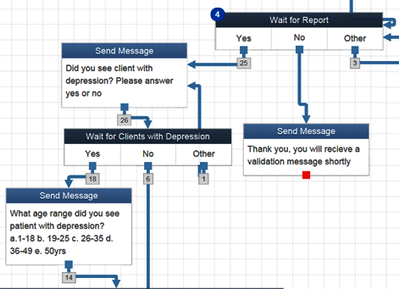
Step 2: Develop & Test Workflow
Belize
Notes:
Those questions are input into RapidPro or another SMS system. This is a screen shot of a workflow created in Rapid Pro. You can see how the responses move through the system based on how health workers respond.

Slide 16
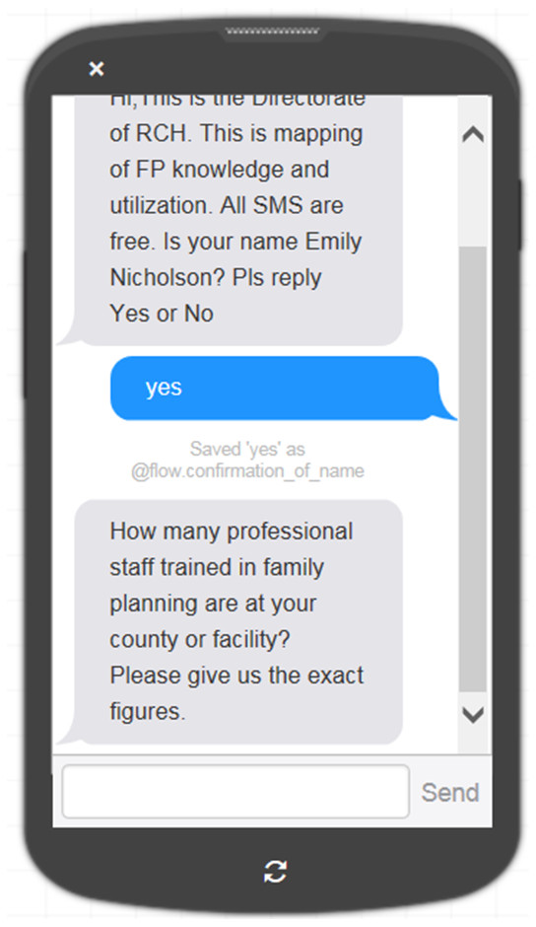
Step 2: Develop & Test Workflow
Notes:
Once your workflow is complete, be sure to test it with the RapidPro synchronizer. It is important that you answer each question in a variety of ways to make sure that the flow contains no errors. You may also want to get others on your team to test the workflow. Testing is an important part of the process.

Slide 17
Step 3: Select Recipients
1. Define mHero use case
2. Develop and test work flow (RapidPro)
3. Select health workers to contact (iHRIS)
4. Send message to a set of health workers
5. Monitor message transmission
7. Analyze mHero data and act accordingly
6. Export mHero data for analysis
8. Implement use case with another set of health workers or close workflow
Notes:
When the workflow is ready to be deployed, the health workers that will receive the messages must be identified. This might include only certain cadres of health workers, or only health workers in certain facilities. Through iHRIS, mHero can target communications based on the implementer’s needs.

Slide 18
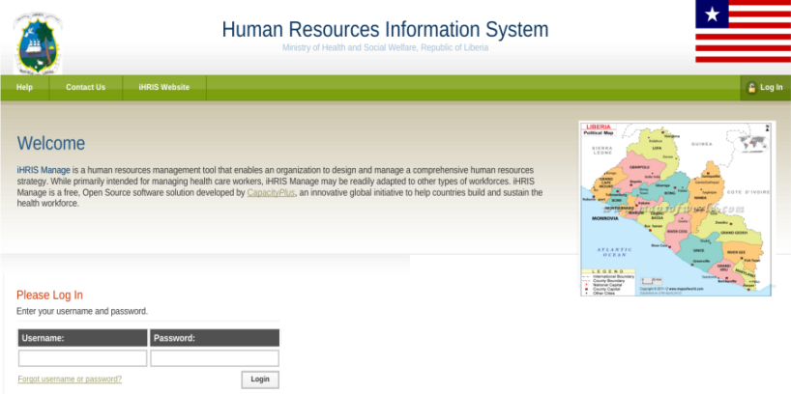
Step 3: Select Health Workers for the Workflow
Notes:
In doing this step, first you must log into iHRIS.

Slide 19
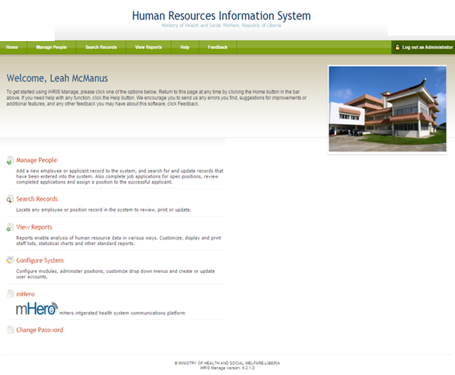
Notes:
The mHero function is found on the iHRIS landing page.

Slide 20
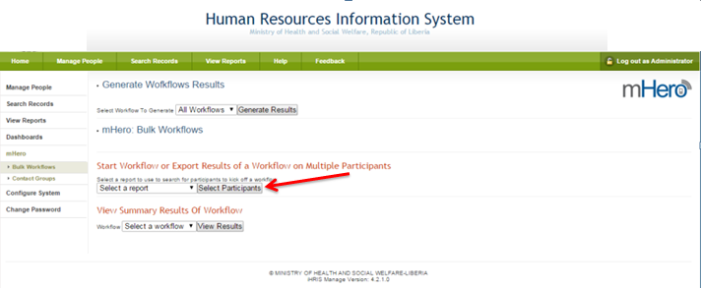
Notes:
You will begin by selecting the health workers to whom you would like to send messages. iHRIS makes it easy for you to disaggregate by cadre, facility etc.

Slide 21
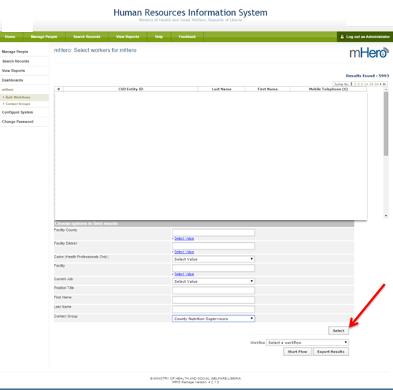
Notes:
After recipients have been identified, click “select”

Slide 22
Step 4: Send Messages
1. Define mHero use case
2. Develop and test work flow (RapidPro)
3. Select health workers to contact (iHRIS)
4. Send message to a set of health workers
5. Monitor message transmission
7. Analyze mHero data and act accordingly
6. Export mHero data for analysis
8. Implement use case with another set of health workers or close workflow
Notes:
The next part of the process is to send the messages. Once recipient health workers have been selected, SMS can be sent.

Slide 23
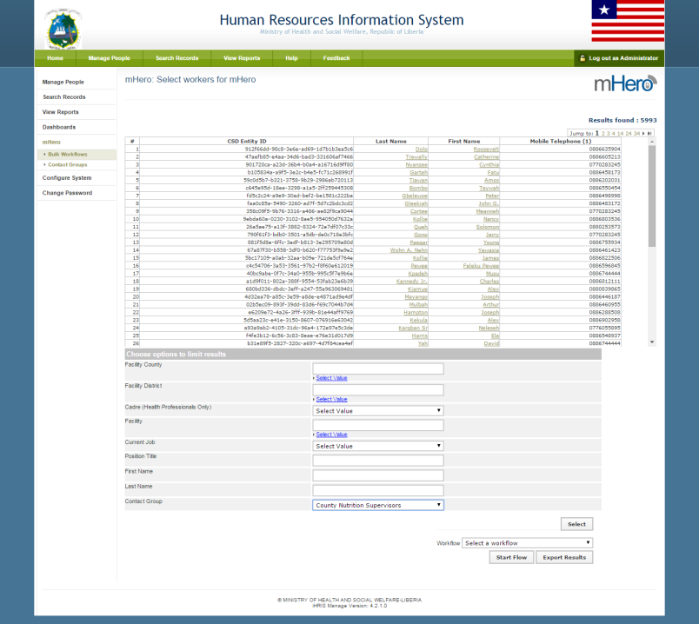
Notes:
In iHRIS, select a pre-created workflow from the drop down menu and click “start flow.” Remember the workflow name that you want to send - as you recall earlier we mentioned how important it is to give our workflow a clear name.
This activates the mHero workflow, which will send all associated SMS – whether 3 questions or 20 questions.

Slide 24
Step 5: Monitor Message Transmission
1. Define mHero use case
2. Develop and test work flow (RapidPro)
3. Select health workers to contact (iHRIS)
4. Send message to a set of health workers
5. Monitor message transmission
7. Analyze mHero data and act accordingly
6. Export mHero data for analysis
8. Implement use case with another set of health workers or close workflow
Notes:
While the workflow is ongoing, the ministry can view the responses, particularly to monitor if health workers are responding to the SMS. Monitoring how the messages are going out and being received through RapidPro is important in case you need to troubleshoot any technology challenges.

Slide 25
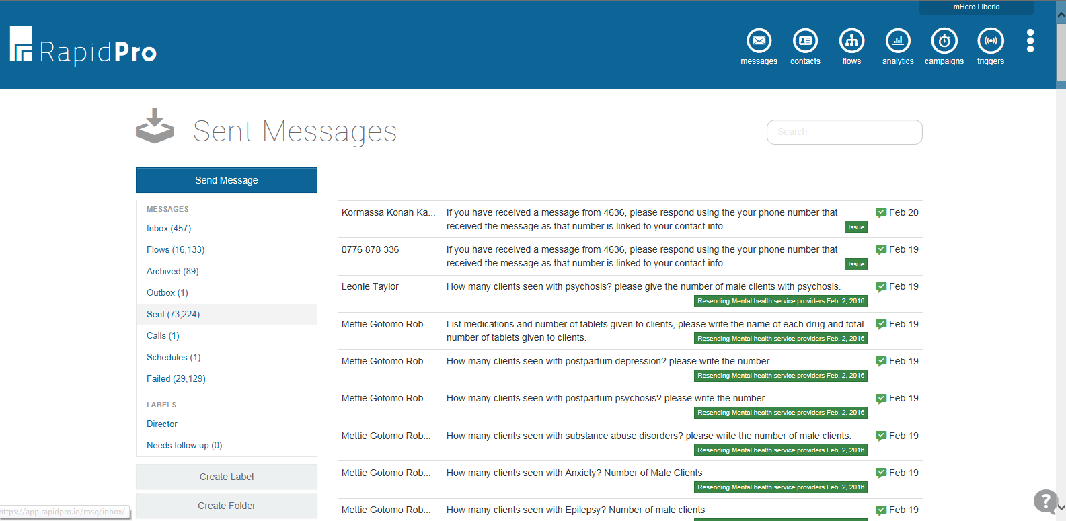
Step 5: Monitor Message Transmission
Notes:
As you can see here, RapidPro allows you to see which messages have reached recipients and which did not go through. Failed messages may be the result of an incorrect health worker phone number, a health worker being outside of network coverage area, or something else.

Slide 26
Step 6: Export mHero Data for Analysis
1. Define mHero use case
2. Develop and test work flow (RapidPro)
3. Select health workers to contact (iHRIS)
4. Send message to a set of health workers
5. Monitor message transmission
7. Analyze mHero data and act accordingly
6. Export mHero data for analysis
8. Implement use case with another set of health workers or close workflow
Notes:
Once the workflow is complete, it is time to look at the data. mHero data can be exported from iHRIS into Excel for in depth analysis.

Slide 27
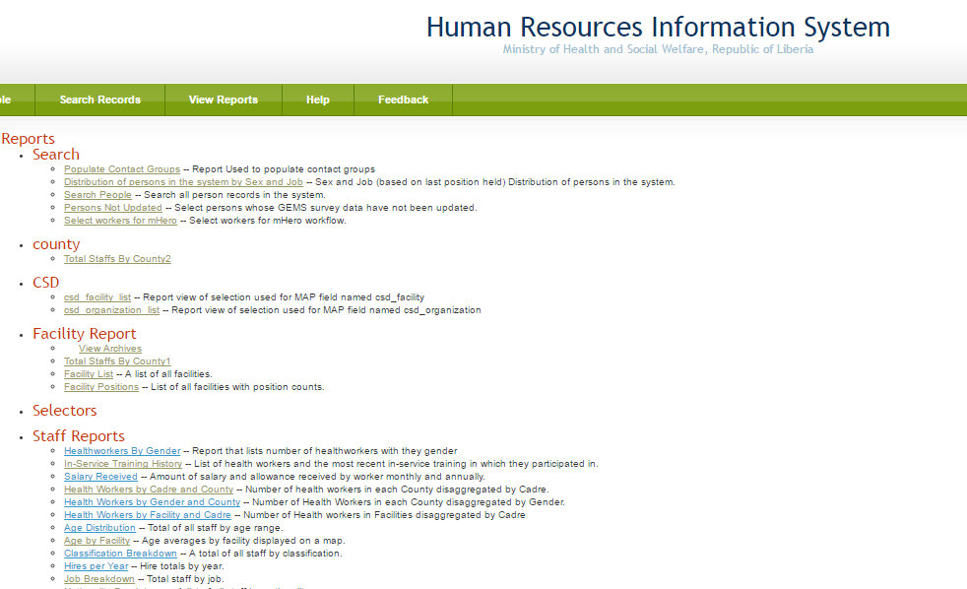
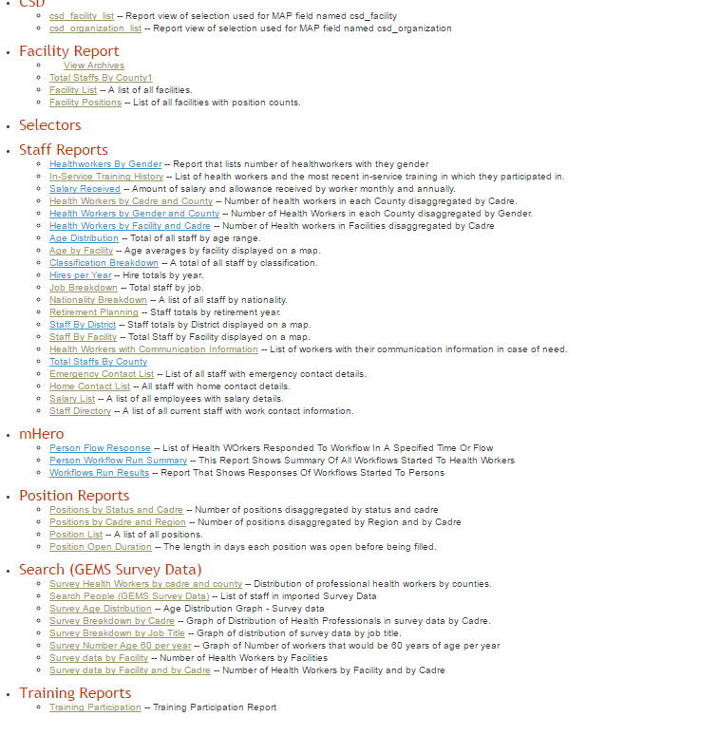
Step 6 : Export mHero Data for Analysis
Workflow Run Results Report
Notes:
This slide shows you how to get the data from iHRIS. Clicking on “Workflow Run Results” under mHero on the “Reports” page in iHRIS will allow you to run a report of health worker responses to a workflow.

Slide 28
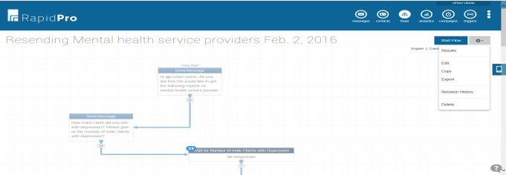
Step 6 : Export mHero Data for Analysis
Notes:
You can also see the results through RapidPro as shown here. There are several tools for looking at the data in a graph form or in a raw data form so you can do deeper analysis.

Slide 29
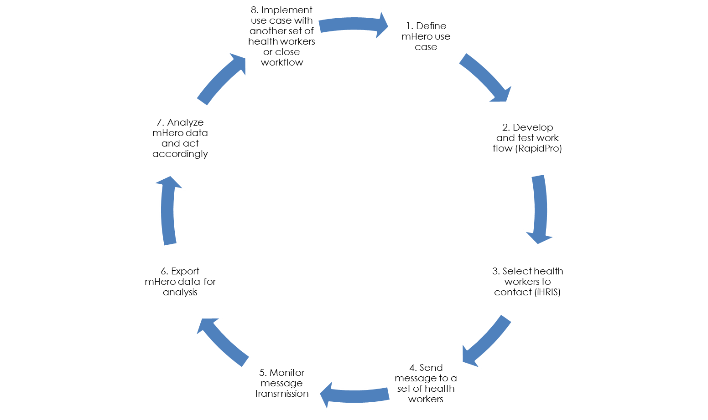
Step 7: Analyze mHero Data and Act
Notes:
mHero users at the Ministry should document the responses, looking for trends, priority needs, and other feedback that will be useful for decision-makers.
It is helpful to complete a report for ministry leadership and other decision-makers who can use an analysis of the mHero results to make decisions to support health workers.
For example, if health workers in one facility are reporting ongoing stockouts of essential supplies, the ministry can look at the supply chain supporting that facility and strengthen it.
After the use case is done, the ministry may choose to close it or redeploy the same use case in another region or with another set of health workers.

Slide 30
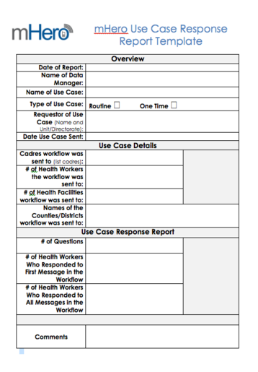
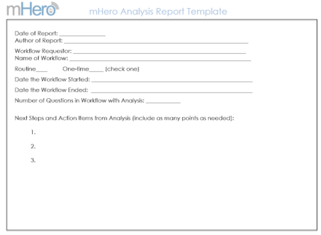
Step 7: Analyze mHero Data and Act
Notes:
After exporting mHero data into Excel and running analysis, the information obtained can be presented using both the mHero Analysis Report Template and Use Case Report Template, available on the mHero website.

Slide 31
Step 8: Implement Use Case Again
1. Define mHero use case
2. Develop and test work flow (RapidPro)
3. Determine which health workers to contact (iHRIS)
4. Send message to a set of health workers
5. Monitor message transmission
7. Analyze mHero data and act accordingly
6. Export mHero data for analysis
8. Implement use case with another set of health workers or close workflow
Notes:
After the use case is done, the ministry may choose to close it or redeploy the same use case in another region or with another set of health workers.

Slide 32
Implementing mHero
Notes:
Now that we’ve walked through the process for sending an mHero SMS, let’s briefly look at the resources needed to implement mHero and discuss the platform’s sustainability.

Slide 33
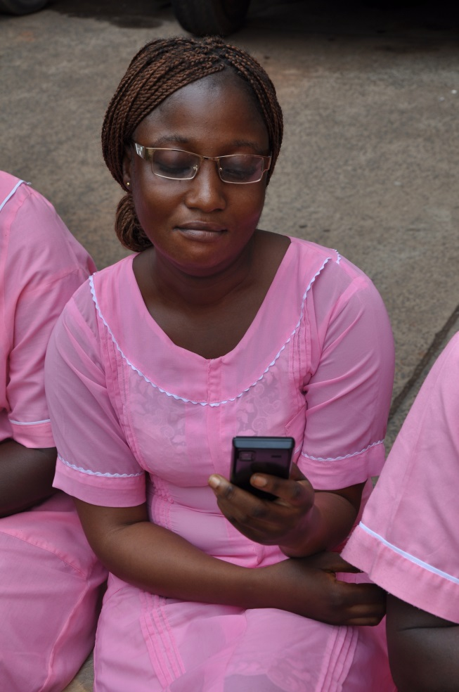
Resources Needed
Health worker information and database
Workflow development platform
Computers, servers, etc.
Short code and VPN for
Internet access
Mobile phones and network coverage
Staff
Coordinator
Team to mange and monitor mHero
mHero Steering Committee (Senior Leadership)
Notes:
This slide overviews the resources needed to implement mHero in a country, both equipment and infrastructure needs as well as human resources.
You know from our previous slides you need a human resource information system such as IntraHealth’s iHRIS. You also need a SMS platform such as RapidPro. Ensuring these are open source is important for sustainability and growth.
There are several important technology tools needed such as computers. You may choose to host the data for iHRIS and mHero on a server or in the cloud. In either case, ensure you have a backup source for hosting. Be sure you have reliable internet – an important consideration!
You will also need a short code from a mobile network operator. A Virtual Private Network (VPN) is necessary to connect a RapidPro instance to a mobile network and a short code is used to connect a mobile network to multiple mobile phones.
Finally you will need a dedicated team to support mHero. You may organize your team to have a coordinator that oversees the entire process and ensures strategic alignment with MOH priorities. This coordinator could oversee data managers who implement mHero. However you structure your team, ensure they have clear roles and responsibilities.

Slide 34
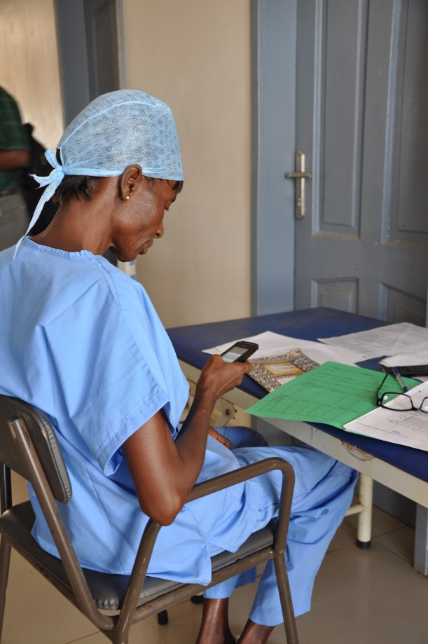
mHero is Sustainable
Integrated into iHRIS - not a new system!
Utilizes Open Source
software
Supported by global network
iHRIS wiki, iHRIS community
mHero is owned by the MOH
Notes:
Sustainability is very important for any HIS and ICT investment.
mHero is sustainable because it is not a new technology or system but rather integrated into existing iHRIS structure.
mHero uses open source software, so Ministries do not pay licensing fees.
As part of iHRIS, mHero is supported by a global network of developers, implementers and program managers who maintain resources through wiki sites and a community of practice.
Perhaps the most important piece of mHero’s sustainability is that it is owned by the ministries which choose to implement the platform, and as such all messages and agreements for data exchange are developed by ministry staff.

Slide 35
mHero to Date
Implementation in 3 Ebola-affected countries
Regional Collaboration
Inclusion in National HIS strategies and plans
Notes:
Since the first mHero SMS were sent in Liberia in November of 2014, the platform is now being rolled out nationally in Liberia. Implementation is coming soon to Mali, Sierra Leone and Guinea. mHero team members have traveled between Sierra Leone and Liberia to share ideas, best practices and conduct trainings. mHero has also been formally adopted by ministries of health, and is being included in national health information system (HIS) strategies and plans.

Slide 36
What Is mHero?: Collaborators
Notes:
mHero has been developed with support and in collaboration with many stakeholders including UNICEF, USAID, Johnson and Johnson and others. IntraHealth has supported building the capacity to implement and use iHRIS and mHero with the Ministries of Health in Liberia, Sierra Leone and Guinea. The nature of the mHero system is conductive for a wide range of partner collaboration to strengthen health systems.

Slide 37
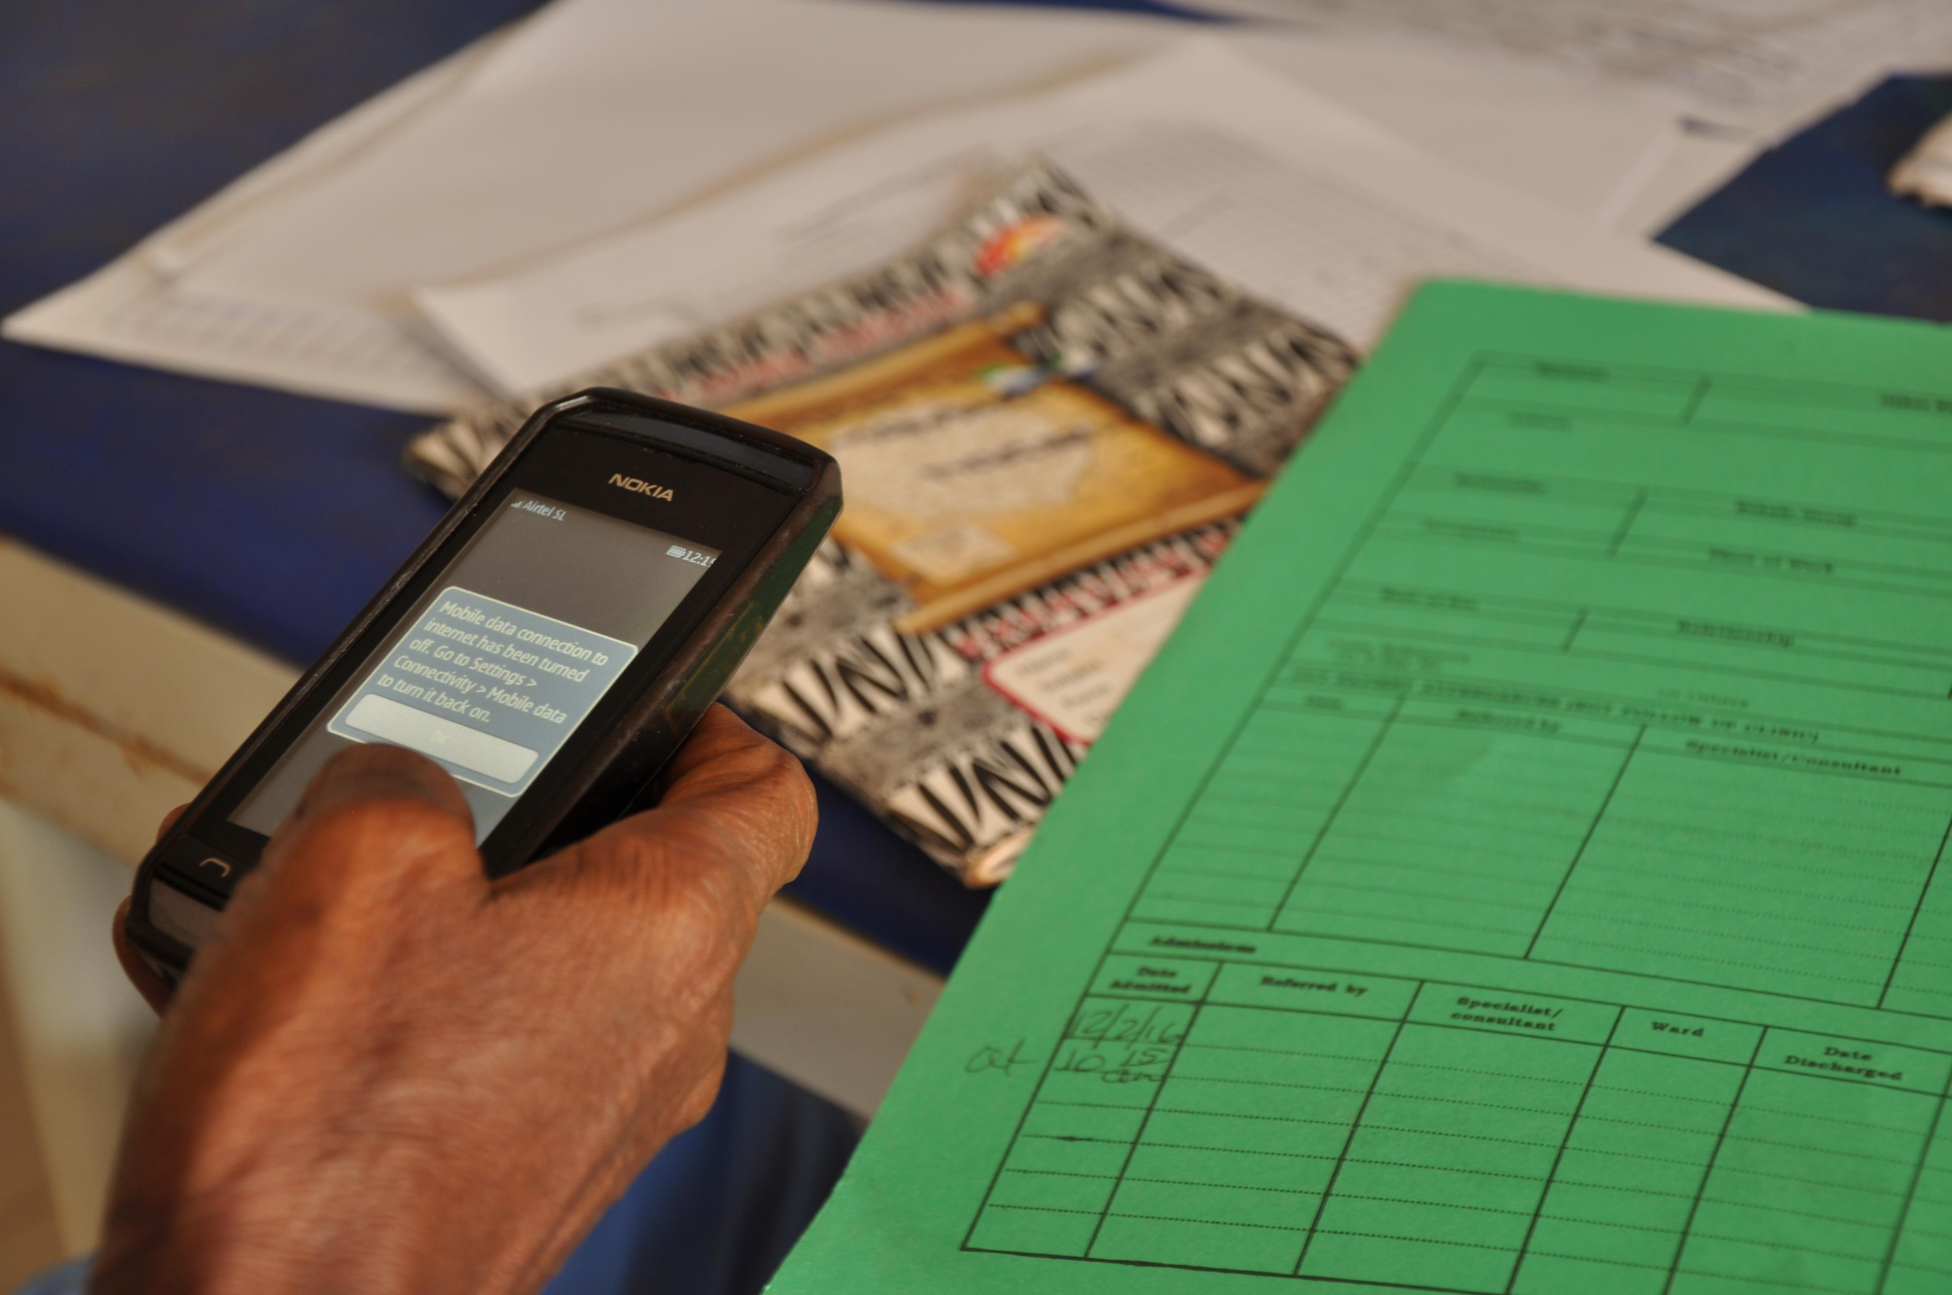
Thank you!
This information is made possible by the generous support of the American people through the United States Agency for International Development (USAID). The contents are the responsibility of IntraHealth International and do not necessarily reflect the views of USAID or the United States Government.
Notes:
This information is made possible by the generous support of the American people through the United States Agency for International Development (USAID). The contents are the responsibility of IntraHealth International and do not necessarily reflect the views of USAID or the United States Government.

