Slide 1
Overview of Data Use
Notes:
Data from health information systems like mHero can be used in may different ways. For example, data can be used for advocacy and policy development. Data can be used in program evaluation and strategic planning. It can be used to manage programs and improve support to health workers who provide a wide range of health services.
In this presentation we will talk about the determinants of data use and go through a typical cycle of data use. We will talk about how this cycle applies to mHero and the implementers involved in mHero.
Let me first start by saying much of the information in this presentation can be found through the MEASURE Evaluation Project’s “Introduction to Basic Data Analysis and Interpretation for Health Programs: A Training ToolKit”.

Slide 2
Determinants of Data Use
Technical Determinants
Processes and Tools for Data Collection and Use
Data Availability
Organizational Framework
Logitistical systems, information culture, technological infrastructure
Individual Behavior
Knowledge, skills, attitudes and values of people who collect and use data
MEASURE Evaluation, 2006
Notes:
Several determinants directly affect whether or not data is used:
Technical determinants refer to the technical aspects of data collection: processes, such as the data collection processes, tools, forms, infrastructure, and staff capacity in M&E tasks. For example,
Skills such as data analysis or computer literacy are critical to ensuring data use;
The presence of key M&E infrastructure such as computers;
- Also the data systems that are the foundation of data-informed decision making
must be sound. For example indicators need to be relevant and well defined for use. Data quality assurance protocols also need to be in place. Without these stakeholders – the leaders and managers involved in requesting use cases and guiding the questions posed and data collected -- won’t trust and therefore won’t want to use them.
When we think about what affects the use of information most of us think of issues in this this technical category of determinants of data use.
“Organizational determinants” relates to the organizational supports that contribute to data collection, availability, and use. Overall, as we have stressed in this workshop, having good leaders at all levels of the organization is key to ensuring that staff take responsibility for overcoming challenges and enabling the achievement of team results. Other examples of organizational supports include:
a monitoring and evaluation plan linked to a program plan, with clear targets and desired increases, which is regularly reviewed;
a mission statement, vision, or strategic plan that seeks to achieve data-informed decision making;
organizational policies or procedures for data use, data management, data quality, or data sharing;
guidelines for registering new research;
clear roles and responsibilities of those who collect, analyze, disseminate, and use data; and
regular forums or meetings scheduled and implemented for data-user and data-producer interactions.
These types of organizational supports greatly affect the use of information, yet they are not often considered when working to improve data demand and use.
Lastly individual determinants. These refer to the behavior of individuals who produce and use data. This would cover their skills, attitudes, values, and motivation of individuals within an organization.
For instance:
The attitude of decision makers will play a big role in determining if data and information are used. If decision makers have no interest in using data, they will make decisions based on other factors;
Staff motivation to collect quality data, analyze the data, and use them; and
The lack of a data culture – by a culture we mean an environment where everyone understand their role in the data use process, value this role, and work to support the functioning of a data use culture.

Slide 3
Typical Cycle for Data Use
Understand Information Needs
Identify Data Sources
Design Data Collection Tool
Collect Data
Analyze and Interpret Data
Data Summary and Presentation
Make Data Actionable and Craft Solutions
Facilitate Feedback
Notes:
Data Use is not just analytics. It is not just creating a pie chart or running a report of indicators. Data Use is a process and it is cyclical. We’ll walk through these eight steps that are part of the data use process. Even if you are involved in a few of these, you should be aware of how these steps flow together.

Slide 4
Understanding Information Needs
Important to understand stakeholder needs
Identify the right questions
Consider when and how you communicate to stakeholders
Understand Information Needs
Identify Data Sources
Design Data Collection Tool
Collect Data
Analyze and Interpret Data
Data Summary and Presentation
Make Data Actionable and Craft Solutions
Facilitate Feedback
Notes:
First, you need to understand the information needs. What are the questions that need to be answered and who needs that information? What are the stakeholder’s goals? Remember, stakeholders are the leaders and managers involved in requesting use cases and guiding the questions posed and data collected. They use the information collected to help make decisions or develop health policies.
One of the most important things to consider when collecting, analyzing and using data is your stakeholder. You should know from the beginning, who is your stakeholder and what information do they need. This seems quite simple but as many of us dive deep into data collection and analysis, we forget about our decisions form whom this data is for.
Knowing the answers your stakeholders need will guide the entire data use process.
Another thing to consider is when and how you communication data and information to stakeholders? As a result of the different roles people play and the decisions they make, it is important to ensure that the information they need is clearly communicated. Consider when you communicate – through email or at a meeting. Timing can be important and in person may offer a better medium for discussion. You should also consider how you communicate. Remember that some stakeholders won’t have a background in research methods or analytics. Technical jargon like “confidence interval” may not mean very much. Another thing to consider is what tools you use to communicate data and information. We will discuss more about data visualization later but sometimes a visual representation such as a graph or map can be much easier to understand and much more powerful than a report.

Slide 5
Understanding mHero Needs
Work with MOH and external stakeholders to determine information needs
Formal request process with Use Case Request form
Set expectations about data analysis
Understand Information Needs
Identify Data Sources
Design Data Collection Tool
Collect Data
Analyze and Interpret Data
Data Summary and Presentation
Make Data Actionable and Craft Solutions
Facilitate Feedback
Notes:
mHero users will need to work with heads of departments and other stakeholders to learn exactly what information they need from health workers. The Use Case Request form is the formal way to make the request of the mHero team. However, the team should thoughtfully engage stakeholders about what their goals are for using this information, the types of questions they want to ask, the number of questions they want to ask, who needs to be included in the workflow and when they need the data. It is also good for the users and the stakeholders to talk about expectations for data analysis. Some mHero teams will do the analysis themselves and deliver a report to stakeholders while other mHero teams may give the raw data to the stakeholders. These steps should all be clear in the beginning.

Slide 6
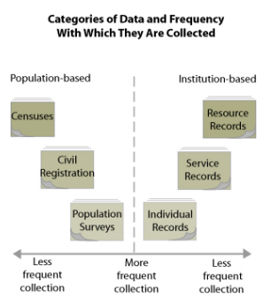
Identifying Data Sources
WHO HMN 2008
Understand Information Needs
Identify Data Sources
Design Data Collection Tool
Collect Data
Analyze and Interpret Data
Data Summary and Presentation
Make Data Actionable and Craft Solutions
Facilitate Feedback
Notes:
Once a need for data or information has been identified, you have to determine where to find that information. Don’t assume it does not already exist.
Data can be collected in either a continual, on-going basis or periodically at one or more points in time, depending upon how the data is to be used. Data can be categorized into two general source types. Population-based sources include population counts, national censuses, civil registration, and other household/population surveys. Institution-based sources include records from government institutions like schools, police stations, or hospitals, member lists from organizations, meeting notes, or government or agency reports. Your program is probably part of an institution that is periodically tasked with the collection of data in order to report on the results of your activities. One may utilize some of the aforementioned sources of data in order to analyze and compare your program findings. Many programs need to generate their own data (thus themselves becoming a source of information) in order to report on specific indicators.

Slide 7
mHero as a Possible Data Source
If information is not available, mHero may be a viable tool to collect information from frontline health workers
Spotlight: Mental Health Information in Liberia
Understand Information Needs
Identify Data Sources
Design Data Collection Tool
Collect Data
Analyze and Interpret Data
Data Summary and Presentation
Make Data Actionable and Craft Solutions
Facilitate Feedback
Notes:
You may find that mHero is a good potential data source for your information needs. mHero can be used to find out information from health workers that does not exist elsewhere. It can also be used to provide up to date information.
An example of when mHero was used to fill a gap is in Liberia for information on mental health services. Currently, no data is collected in DHIS 2 or other system on the types of mental health services provided to clients throughout Liberia. Mental health is especially important after the country has faced years of civil war and is recovering from the Ebola outbreak. The Mental Health team at the MOHSW used mHero to collect some basic information on the types of mental health services provided to patients. For the first time ever the unit had data, which can inform how the unit directs its funding.
You can read more about this unique use of mHero in the Mental Health Information in Liberia Spotlight, which can be found on the mHero website.

Slide 8
Design Data Collection Tool
Narrow list of topics you want to ask about to what will be helpful in analysis and meets stakeholder needs
Questions should be clear
and focused
Only ask one question at a time
Consider your data analysis process
Quantitative data
Qualitative data
See mHero Workflow Development Tips in our Toolbox for more details
Understand Information Needs
Identify Data Sources
Design Data Collection Tool
Collect Data
Analyze and Interpret Data
Data Summary and Presentation
Make Data Actionable and Craft Solutions
Facilitate Feedback
Notes:
There are many different types of data collection tools. Surveys, interviews, focus group discussions and observations are just a few ways to collect data.
We will remind you of a few tips:
Narrow list of topics you want to ask about to what will be helpful in analysis and meets stakeholder needs so that your data collection tool is focused and concise. Questions should be clear and focused one topic or data indicator you wish you get information about. Only ask one question at a time and do not ask about two things in one question. An example of this would be, “Do you provide antenatal care and family planning at your health facility?” This question is asking about two services and some facilities may only provide one service, making it difficult to answer this question.
When designing your data collection tool, you should think about the data analysis process and how this impacts the type of data that you want to collect. Quantitative data is collected through multiple choice questions, or numerical responses and can specifically counted. Analyzing quantitative data could be less time consuming because it is easier to summarize if you have the expertise in cleaning and running analyses. Quantitative is collected through surveys or other project monitoring tools. Qualitative data is collected through open-ended questions and can take longer to analyze and sort responses. Typically these questions are found in interview guides and focus group guides but shorter open-ended questions can be found on surveys as well.
Many of these tips can be applied to other data collection tools. See our mHero Development Tips tool in our toolbox for more advice on using mHero for data collection.

Slide 9
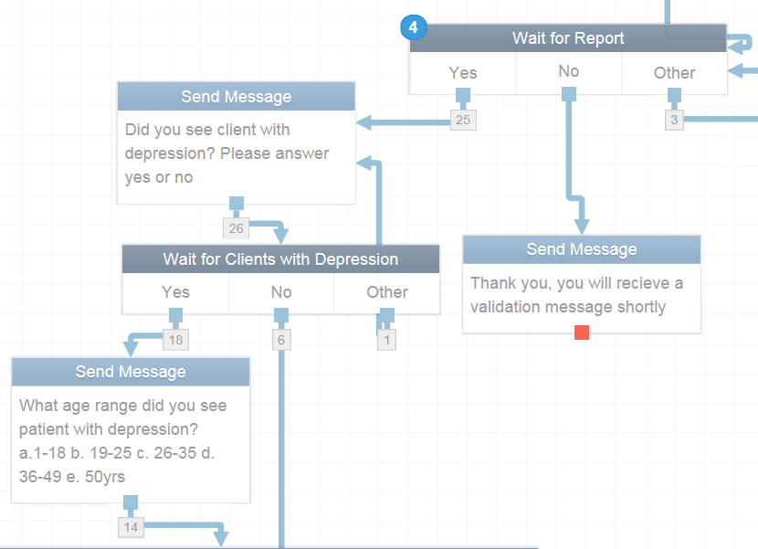
mHero as a Collection Tool
Understand Information Needs
Identify Data Sources
Design Data Collection Tool
Collect Data
Analyze and Interpret Data
Data Summary and Presentation
Make Data Actionable and Craft Solutions
Facilitate Feedback
Notes:
For mHero, RapidPro or another SMS tool is the data collection tool for mHero.
For mHero Users, be sure you understand data collection tools like RapidPro. There are many online tutorials available if you have questions about how to set up workflows.

Slide 10
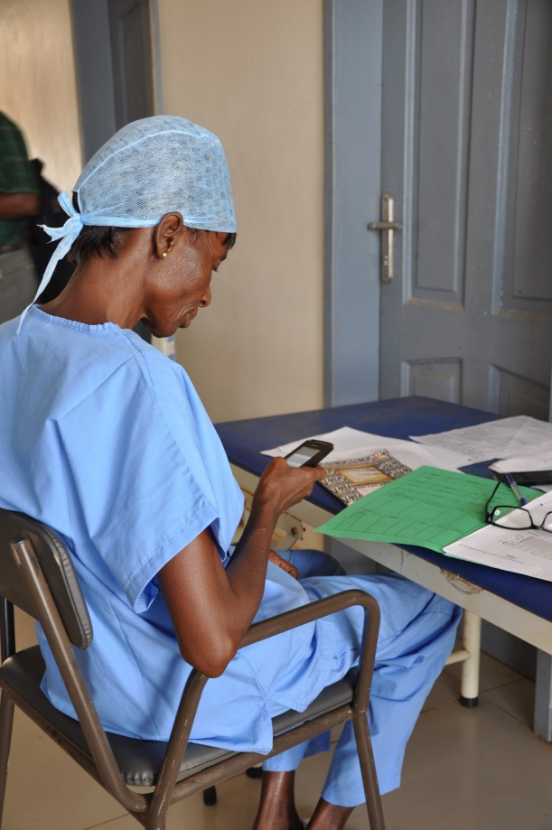
Collect Data
Process of gathering information to answer your stakeholder questions
Qualitative Data = descriptive
Quantitative Data = numerical
Understand Information Needs
Identify Data Sources
Design Data Collection Tool
Collect Data
Analyze and Interpret Data
Data Summary and Presentation
Make Data Actionable and Craft Solutions
Facilitate Feedback
Notes:
Data Collection is the process of gathering and measuring information to answer research questions, test hypotheses and evaluate outcomes. You can collect data in many different ways – through paper-based surveys, online surveys, through interviews or in focus group discussions.
There are two types of data collected.
Qualitative data is descriptive data. It is data based on observations such as behaviors and can not be measured. A question might ask, “What are the barriers you face in providing family planning services?”.
Quantitative data deals with numbers and captures information on things that can be specifically measured. An example might be “How many health workers at your facility received in-service training on PMTCT last month?

Slide 11
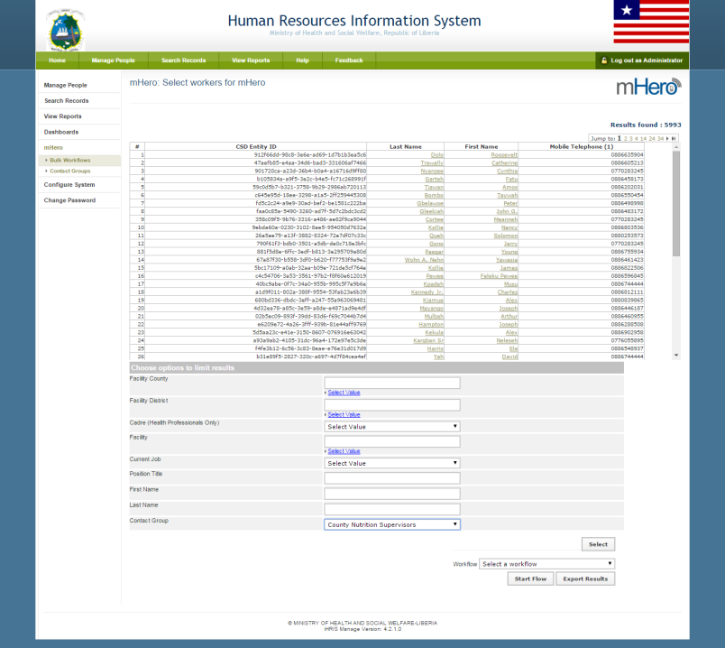
Collect mHero Data
iHRIS allows you to determine exactly who you want to reach to collect data
Understand Information Needs
Identify Data Sources
Design Data Collection Tool
Collect Data
Analyze and Interpret Data
Data Summary and Presentation
Make Data Actionable and Craft Solutions
Facilitate Feedback
Notes:
mHero can collect both quantitative and qualitative data. One of the important parts of mHero data collection is using iHRIS to determine WHO you will collect data from. As you have learned, iHRIS allows you to select mHero recipients by using different variables such as location, cadre, age, facility type etc.
Using this functionality, you can collect data from a large group of health workers, such as all of the nurses in one district; or you can be very selective, such as sending out messages to only nurses and midwives at one facility.
As we previously mentioned, be sure to collect data that is not only useful but also data that can be easily analyzed.

Slide 12
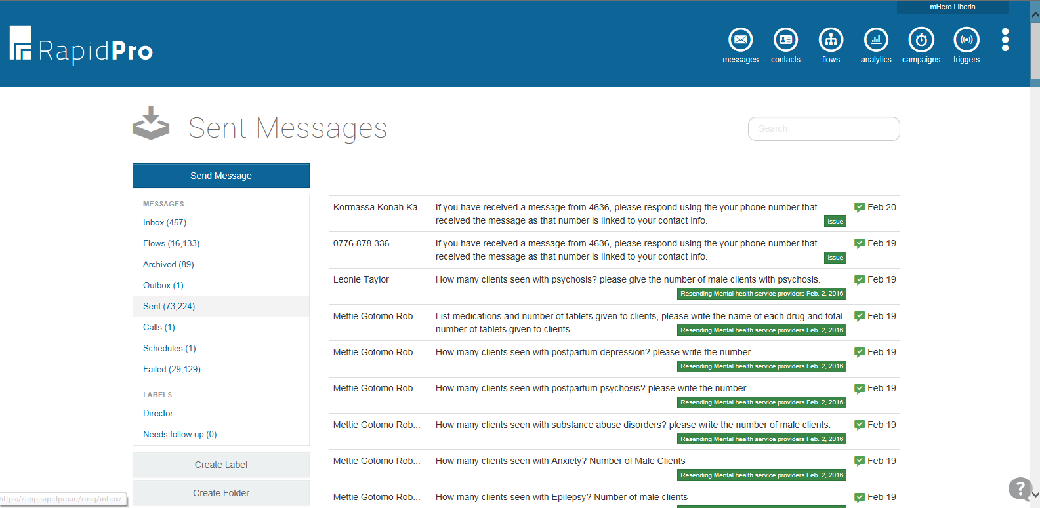
Monitoring Responses
Monitoring Responses is an important part of mHero data collection
Understand Information Needs
Identify Data Sources
Design Data Collection Tool
Collect Data
Analyze and Interpret Data
Data Summary and Presentation
Make Data Actionable and Craft Solutions
Facilitate Feedback
Notes:
Part of data collection is monitoring responses. This is especially important when using technology to collect data. Keep an eye out for any glitches in the system that may need to be resolved by technicians or mHero System Administrators, the technical staff who manage the ICT systems (servers, infrastructure, and software) used by the MoH or health system organization who assist in the technical implementation of mHero by implementing components needed as well as linking them into a working system.
You may also monitor data to give feedback to stakeholders on the response rate for workflows. If response rates are low, you may need to resend the flow or initiate a reminder.

Slide 13
Analyzing and Interpreting Data
Data analysis is turning raw data into useful information
Make sure your data is clean
Interpreting data means using that analysis to further explore finding
Understand Information Needs
Identify Data Sources
Design Data Collection Tool
Collect Data
Analyze and Interpret Data
Data Summary and Presentation
Make Data Actionable and Craft Solutions
Facilitate Feedback
Notes:
Let’s talk about the next step, data analysis. Data analysis is about turning raw data into useful information. Data analysis does not necessarily mean using a complicated computer analysis package. It means taking the data that you collect and looking at them in the context of the questions that you need to answer.
For example, if you need to know how many health providers are trained to provide vasectomies and compare that with the goal of number of trained providers trained to provide vasectomies, that is analysis.
As part of the data analysis process you should always clean your data. I’m sure you’ve heard that before but what does data cleaning mean? Put simply, data cleaning or data scrubbing is the process of detecting and correcting (or removing) corrupt or inaccurate records or entries from a data set. For example if you have exported your mHero data to excel are are looking through the responses to a Yes or No question and see a number in the data set, you would want to remove that because it is not the right variable response to the question.
Interpretation is using the analysis to further explore your findings and understand the implications. In many cases, you may need additional information. means using additional information, such as vital statistics, population-based surveys, and qualitative data, to supplement the routine service statistics. We will talk more about this later in the workshop.
Even the greatest amount and best quality data mean nothing if not properly analyzed—or if not analyzed at all

Slide 14
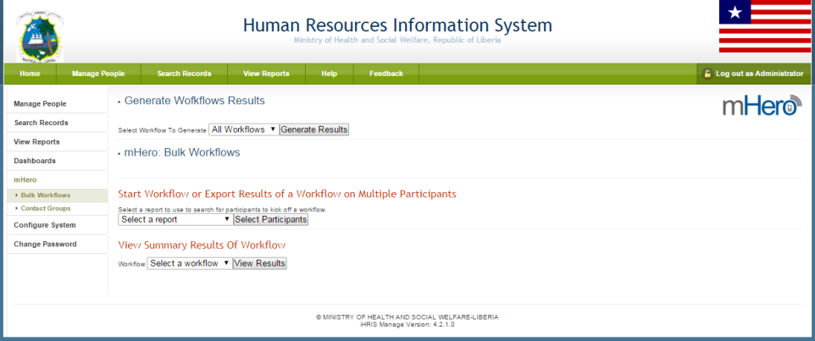
mHero Data Analysis
RapidPro has some data analysis capabilities
A lot of data analysis is done in Excel
Understand Information Needs
Identify Data Sources
Design Data Collection Tool
Collect Data
Analyze and Interpret Data
Data Summary and Presentation
Make Data Actionable and Craft Solutions
Facilitate Feedback
Notes:
There are some capabilities for data analysis in RapidPro but this will have to be done by mHero Users and anyone else who has access to the system.

Slide 15
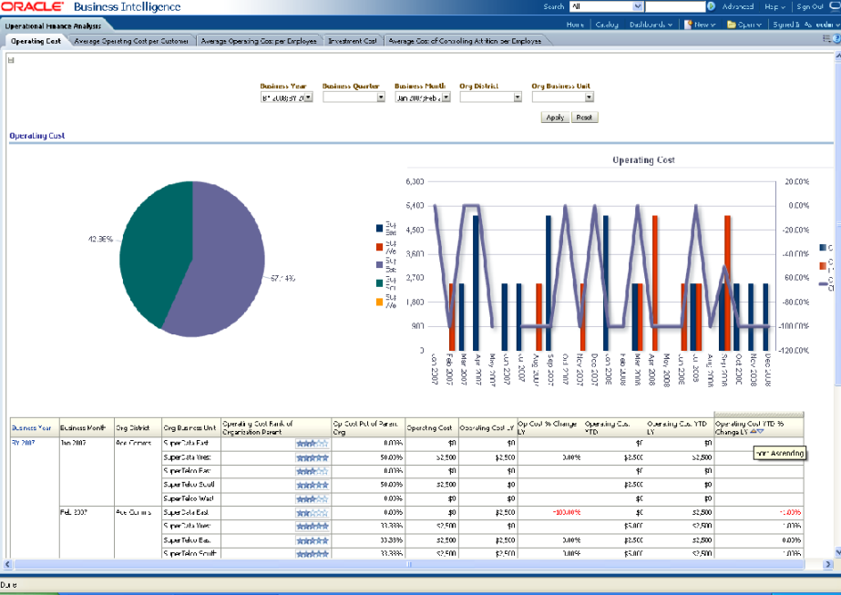
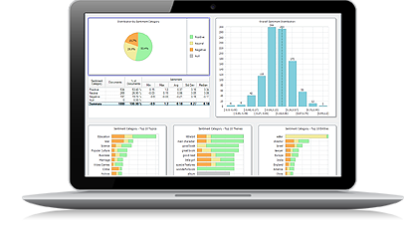
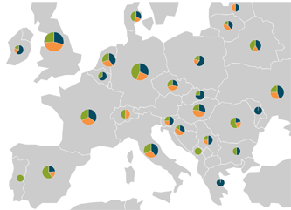
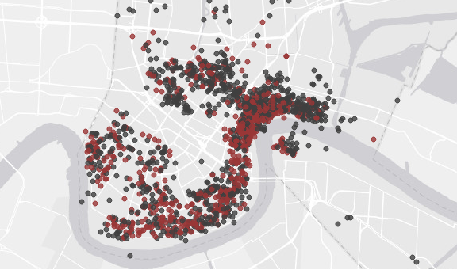
Data Summary and Presentation
Understand Information Needs
Identify Data Sources
Design Data Collection Tool
Collect Data
Analyze and Interpret Data
Data Summary and Presentation
Make Data Actionable and Craft Solutions
Facilitate Feedback
Notes:
When giving stakeholders a report on the data you have found, you should not present every detail. Instead, find the key points to highlight than answer their key questions and will help to inform them most on making decisions.
The several ways of summarizing data. Reports are good to give background but robust data visualization techniques are very effective ways to tell the story for your decision makers. You can do this by using tables and charts. You can use graphs. You can use maps. You can use dashboards for interactive analysis. The images on this slide are just examples of how to visually present some forms of data.

Slide 16
mHero Data Presentation
Understand Information Needs
Identify Data Sources
Design Data Collection Tool
Collect Data
Analyze and Interpret Data
Data Summary and Presentation
Make Data Actionable and Craft Solutions
Facilitate Feedback
Notes:
As with any data presentation and analysis, you want to be sure to include relevant content on your presentations or reports and ensure integrity of the analysis.

Slide 17
Make Data Actionable and Craft Solutions
Relevance of finding
Reasons for finding
Consider other data
Conduct further research
Engage other stakeholders to craft solutions
Brainstorm
Prioritize actions
Make an action plan
Understand Information Needs
Identify Data Sources
Design Data Collection Tool
Collect Data
Analyze and Interpret Data
Data Summary and Presentation
Make Data Actionable and Craft Solutions
Facilitate Feedback
Notes:
The next step in the data use process is making data actionable. This process can be used for mHero or any data for decision making activity.
Making data actionable can be the most challenging part of the whole data for decision making process. You as a stakeholder have the answers to your questions. You have beautiful, easy to read charts explaining the information. Now what do you do?
You may want to walk through the steps in this graphic. Think first about the relevance of the data your team has brought you. Here are some questions to ask yourself:
Did this completely answer your questions and meet your information gaps?
Is this meaningful information for you?
Did anything surprise you?
Were there any highs or lows in the data?
How does the data compare with your targets or what you ideally were hoping for? How close or far away is it?
Asking these questions will help you put the information in the context of your needs.
Next you will want to think about reasons for the findings. You might want to talk with others about the findings or the targets that have been set. Say for example that the HMIS MOH team tells you that 2 out of 12 district HMIS leads were not updating their bi-monthly reports in DHIS 2. You may want to find out more information. Are they coming to work? Do they have working computers? Electricity?
At this point you might want to consider other data as well. This could be looking at other available research or even using mHero to find out more about the situation.
If no other data exists, you may want to conduct further research. In our illustrative example about the DHIS 2 reports, you may want to use mHero to reach out to the district health HMIS staff to find out what those barriers are that are preventing them from submitting their reports.
Do you see how thinking through data and using it makes it actionable?
Next you will want to craft solutions. Engage other stakeholders and discuss the data. Brainstorm potential solutions and prioritize them. Be specific in what you want to do. And make and action plan listing who is accountable for what action.

Slide 18
Feedback
Sharing information is essential for decision making
Feedback to health workers is especially important for mHero implementation
Successful feedback contributes to creating an “information culture”
Image from: https://en.wikipedia.org/wiki/File:Feedback-loop-general.svg
Understand Information Needs
Identify Data Sources
Design Data Collection Tool
Collect Data
Analyze and Interpret Data
Data Summary and Presentation
Make Data Actionable and Craft Solutions
Facilitate Feedback
Notes:
As you know, it is important for information to be shared. Yet one of most overlooked parts of data use is providing feedback to those involved in your data collection and analysis processes. Feedback is simply sharing the results of your data and how you used data to inform decisions. Feedback ensures that those who collected the data benefit from the collection as much as those requesting the data. Also, information needs to be shared regularly and in a timely manner so that a ‘culture of information use’ is supported.
Successful feedback contributes to what is known as the information culture. When information becomes available, it is more likely to be used. When information is shared and used, it becomes an integral part of decision-making processes and empowers people to ask questions, seek improvement, learn, and improve the quality of programs.

Slide 19
Using mHero for Feedback
Sharing Feedback with health workers will improve mHero participation
Feedback is important to stakeholders and mHero Leadership teams
Don’t forget donors and partners – share feedback on results, challenges and how mHero has been used to make decisions
Understand Information Needs
Identify Data Sources
Design Data Collection Tool
Collect Data
Analyze and Interpret Data
Data Summary and Presentation
Make Data Actionable and Craft Solutions
Facilitate Feedback
Notes:
For mHero, feedback is especially important to health workers. By sharing with them how many people participated in a workflow, the results of workflow and how the MOH is using that information to provide better support for them to improve health services, you can build more trust and engagement with the mHero system. More trust translates into more mHero engagement from frontline health workers.
It is also important for stakeholders to provide feedback to mHero implementation teams who are collecting data and analyzing the information. When data collectors or mHero teams understand and see the data’s usefulness, they are more likely to appreciate and value it. This can translate into higher-quality data collection and the collection of appropriate and useful data. Feedback is also an important element of the management and supervision system. Effective communication helps to ensure the use of information for planning and programmatic improvement. Last, staff seeing their data and tracking their progress can function as an incentive to continue striving to improve service delivery.
A few examples of feedback for mHero include:
Sharing information via mHero back to health workers
Sharing reports with health facility managers and district health officers
Including mHero in meetings between stakeholders within the MOH to review and discuss information
Adding mHero to the agenda for meetings between donor and NGO to review information and discuss challenges and opportunities

Slide 20
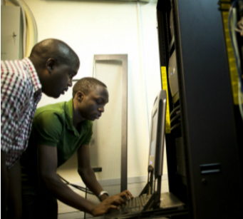
mHero and Data Use
Date Use is important for all implementers involved in mHero
Data Use is an indication of mHero’s ultimate success
Notes:
To wrap up this presentation, we’d like to recap mHero and data use. All implementers involved – users, stakeholders and system administrators– should understand the process of using mHero data.
Users who respond to the stakeholder requests and create the workflows need to consider how they are going to analyze and present data back to the stakeholders.
Administrators support the technology and they should know how the technology needs to be responsive to users and stakeholders needs.
And of course stakeholders use the data. They are integral to the data use process from the beginning to end. When submitting a request for information, stakeholders should be clear on what their questions are and know their goals in getting data using mHero. Stakeholders should be able to take that results and make that data actionable. It will also be up to the stakeholders to initiate any feedback to health workers and others.
Data Use is an indication of mHero’s ultimate success. No matter how many responses you have to workflows or how many health workers know about mHero, the platform is only impactful if decision makers take action.

Slide 21
Thank you!
© IntraHealth International. This document is made available under a Creative Commons Attribution-ShareAlike 4.0 International: https://creativecommons.org/licenses/by-sa/4.0/
This information is made possible by the generous support of the American people through the United States Agency for International Development (USAID). The contents are the responsibility of IntraHealth International and do not necessarily reflect the views of USAID or the United States Government.
Notes:
Slides and Narration by Amanda Puckett BenDor apuckett@intrahealth.org

